Slide 1

UNDERSTANDING INTERNATIONAL CONFLICT
Using Statistical Methods
Notes:
Going to present a dataset that I have used before
But this time with the methods we learned in this class

Slide 2
“War does not determine who’s right- only who’s left”
Notes:
Starting off with a nice quote:

Slide 3
01
HYPOTHESIS
Can statistical methods be used to understand and predict war?

Slide 4
R-Squared: 0.229
PREVIOUSLY..
Notes:
My R-squared from 404, not efficient and week model, but mostly because this data is only linear without outliers. I don’t want to remove the outliers because they are importsnt as you will see

Slide 5
PREVIOUS METHODOLOGY
Data Set
Linear Model with outliers
Kernel Regression Fit
Understanding the Variables
Selecting Variables and Structuring Data
Standard linear regression fit: 0.229 R-squared
Depicts skewed data due to outliers
Variables in question were chosen at random and were not informative

Slide 6
CAN NEW TECHNIQUES PROVIDE NEW INFORMATION?
Issues in the past:
The dataset has highly correlated variables
War Data is not necessarily linear- namely due to its randomness- and it is difficult to select features without bias
We require a way to understand the variables of our data further, with or without outliers, that can give us more information for better models
Sounds like a job for.. Principal Component Analysis!
Notes:
Can we use PCA and FA for these issues? I think I uncovered some interesting facts!

Slide 7
02
EDA:
The data and its context to the domain

Slide 8
DATASET ONE: UCPD WAR
TIME
LOCATION
SIDE A
SIDE B
INCOMPATIBILITY
INTENSITY
REGION
CONFLICT TYPE
The data is depicted from 1948-2020
The data is international- sorted by each country
Group One that is on the offense during war
Group Two that is on the defense during war
1 = Battle
2 = War
1= Extrasystemic
2= Interstate
3= Intrastate
4 = Internationalized Intrastate
1= Territory
2 = Government
3 = Both
1 = Europe
2 = Middle East
3 = Asia
4 = Africa
5= America
Notes:
1 = extrasystemic (between a state and a non-state group outside its own territory, where the government side is fighting to retain control of a territory outside the state system)
2 = interstate (both sides are states in the Gleditsch and Ward membership system).
3 = intrastate (side A is always a government; side B is always one or more rebel groups; there is no involvement of foreign governments with troops, i.e. there is no side_a_2nd or side_b_2nd coded)
4 = internationalized intrastate (side A is always a government; side B is always one or more rebel groups; there is involvement of foreign governments with troops, i.e. there is at least ONE side_a_2nd or side_b_2nd coded)

Slide 9
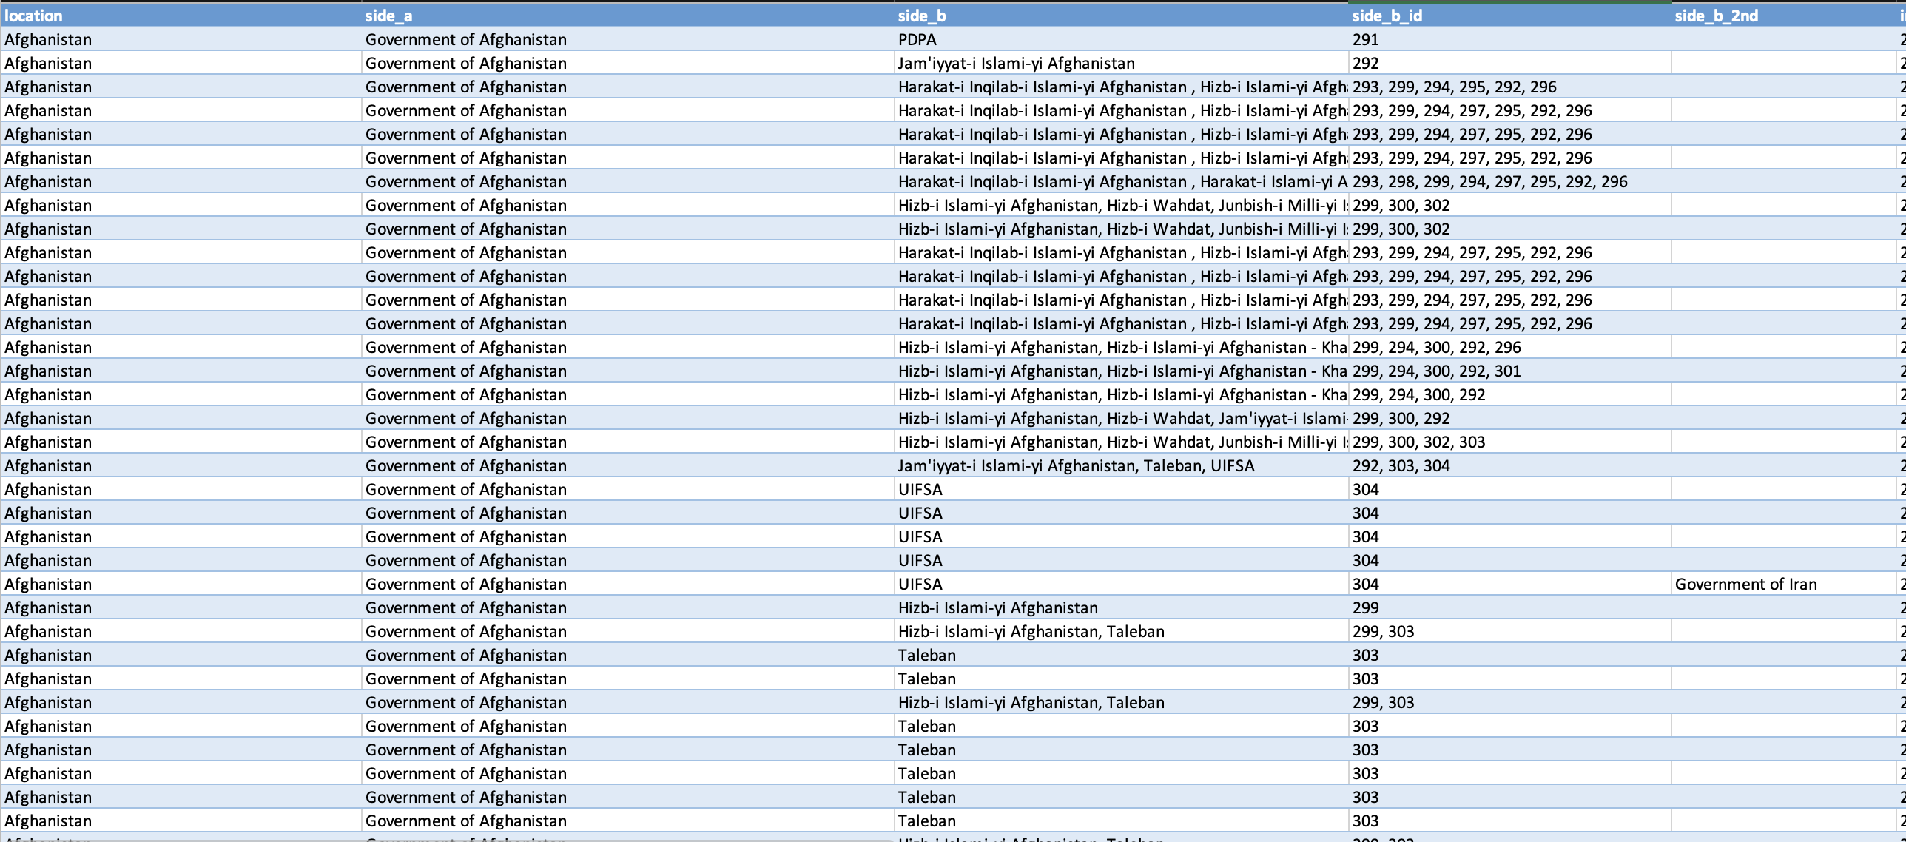
DATASET ONE: UCPD WAR

Slide 10
55%
75%
74%
TERRITORY
More than half the battles in the dataset have been over territory
BATTLES
A vast majority of conflict is battle, <999 deaths by UCPD standard
INTRASTATE
Conflict was a government vs. one or more rebel groups

Slide 11
WAR BY REGION
40%
ASIA
14%
MIDDLE EAST
32%
AFRICA

Slide 12
DATASET TWO: WAR
Need: A numerical dataset
UCPD War data is a count of every instance of war with obsolete variables
Combine this count and attach it to numerical variables

Slide 13
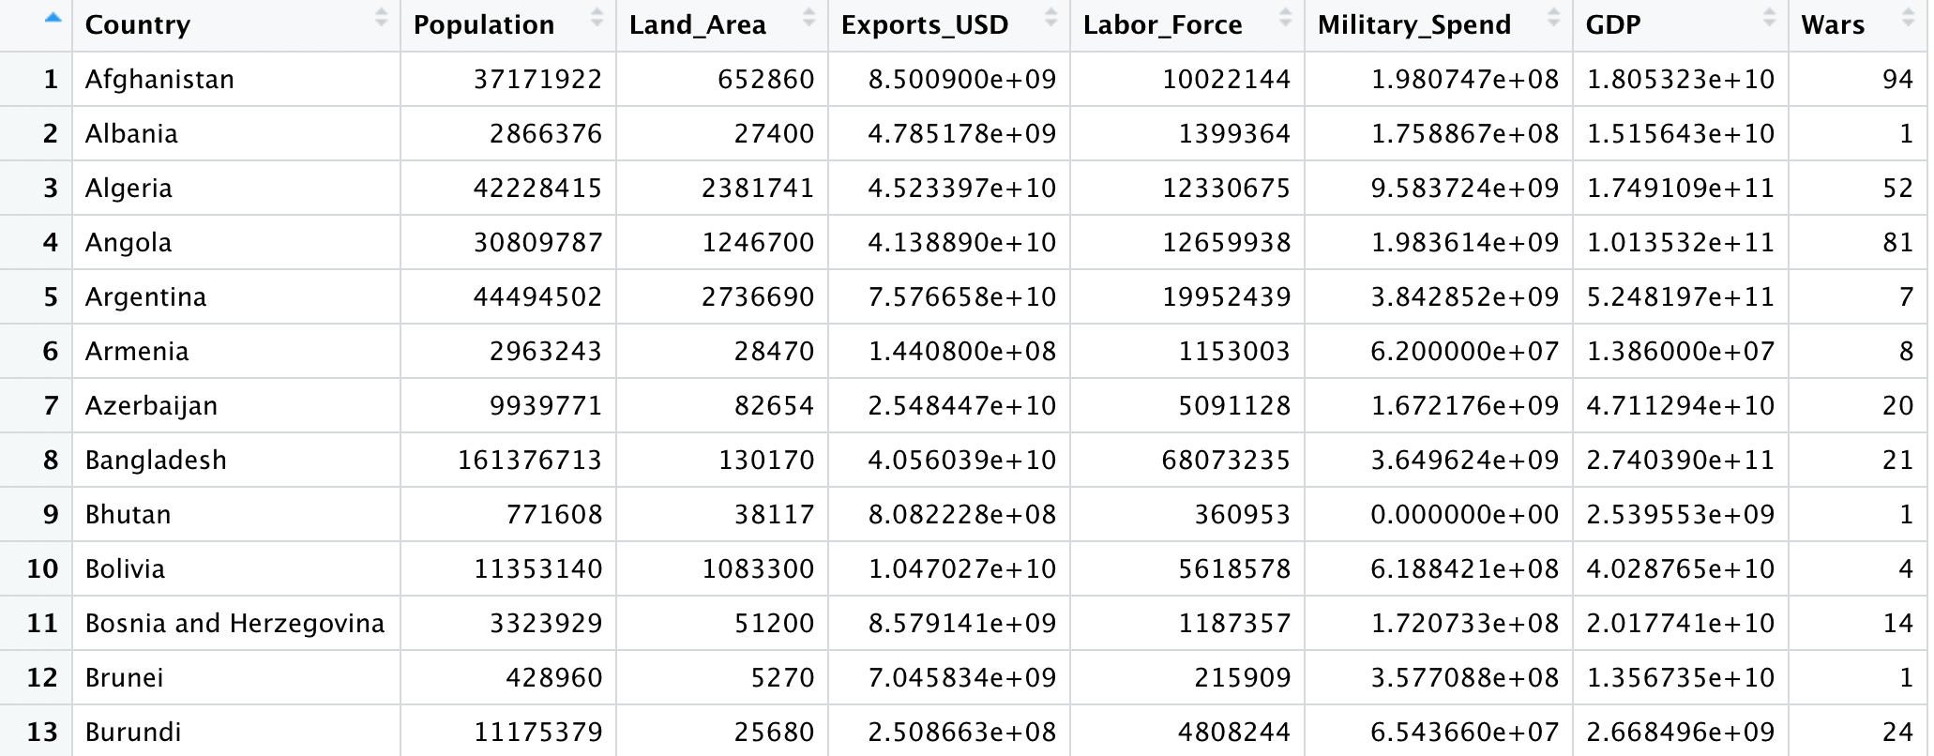
DATASET TWO: WAR
Notes:
Of course there are some draw backs to this data set. Its based on the intensity of the war 1 or 2 so anyone with war gets a double count. Also this is for war on TERRITORY
so even if a country is involved in another war it will only get a count for if it happened on their land

Slide 14
DATASET TWO: WAR
Country
Population
Land Size
Exports
Labor Force
GDP
Wars
Military Spend
Nation
Average Value from 1948-2021
Square Foot average of every country
Average Exports in USD
Total concatenated value (count of total wars in time frame)
Average number of people in the working force
Average military spend in USD
Average population spend in USD

Slide 15
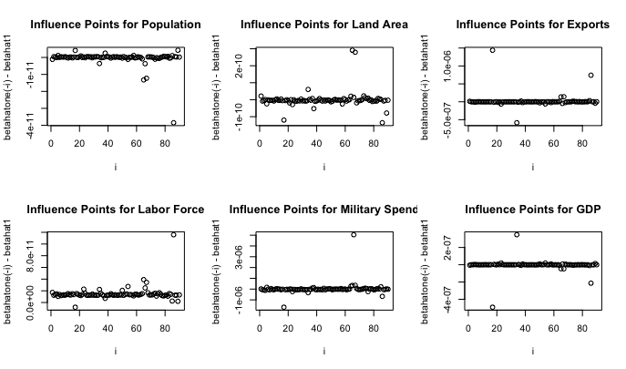
INFLUENCE PLOTS
OUTLIERS
Every variable has its own outliers, which poses as a big issue since they are all highly influential. Note as well that the monetary values are very large.

Slide 16
OUTLIERS BY VARIABLE
Population | 10 | Bangladesh, China, India, Indonesia, Japan, Mexico, Nigeria, Pakistan, Russia, U.S.
Land Size | 11 | Bangladesh, China, India, Indonesia, Japan, Mexico, Nigeria, Pakistan, Russia, U.S., Vietnam
Exports | 8 | Algeria, Argentina, China, Colombia, DR Congo, India, Russia, Saudia Arabia, U.S.
Labor Force | 16 | China, Denmark, France, India, Indonesia, Ireland, Japan, Mexico, Russia, Saudia Arabia, South Korea, Thailand, Turkey, UK, U.S., Vietnam
Military Spend | 11 | China, France, India, Israel, Japan, Romania, Rwanda, South Africa, Turkey, UK, U.S.

Slide 17
03
PCA
Principal Component Analysis

Slide 18
PCA OBJECTIVES
01
02
03
Data Reduction
Interpretation
Intermediary
“Though 𝑝 components are required to reproduce the total system variability, much of this variability can be accounted for by a small number 𝑘 of the principal components. : these 𝑘 principal components can then replace the initial 𝑝 variable.”
“PCA reveals relationships that were not previously suspected and allows interpretations.” Additionally, these new relationships can bring research questions that surface from the extended knowledge on the domain.
“Serve as intermediate steps in larger investigations” PCA is often used as a task in machine learning before equipping the model with its data.

Slide 19
SUMMARY OF COMPONENTS
69%
Variance explained by Component 1
17%
Variance explained by Component 2
10%
Variance explained by Component 3

Slide 20
EIGENVECTORS: CORRELATION MATRIX
People Component
Variables that the “people” are in control of
Economic Component
Variables that explain working class and spend
Land Component
Land size has an exceptionally high eigenvalue
Monetary
Component
Exports and Military spend are monetary values
Labor
Component
Population and labor force explain variability
Population
0.459761
0.5335745
-0.09585589
-0.30563192
0.63349703
Land Size
0.3954616
-0.2263718
0.88826757
-0.05686546
0.01062996
Exports
0.4876755
-0.2712185
-0.23964172
0.7667188
0.20815183
Labor Force
0.4815583
0.4639383
-0.08531171
0.03149660
-0.73796528
Military Spend
0.4031176
-0.6125813
-0.37025145
-0.56080799
-0.10319193

Slide 21
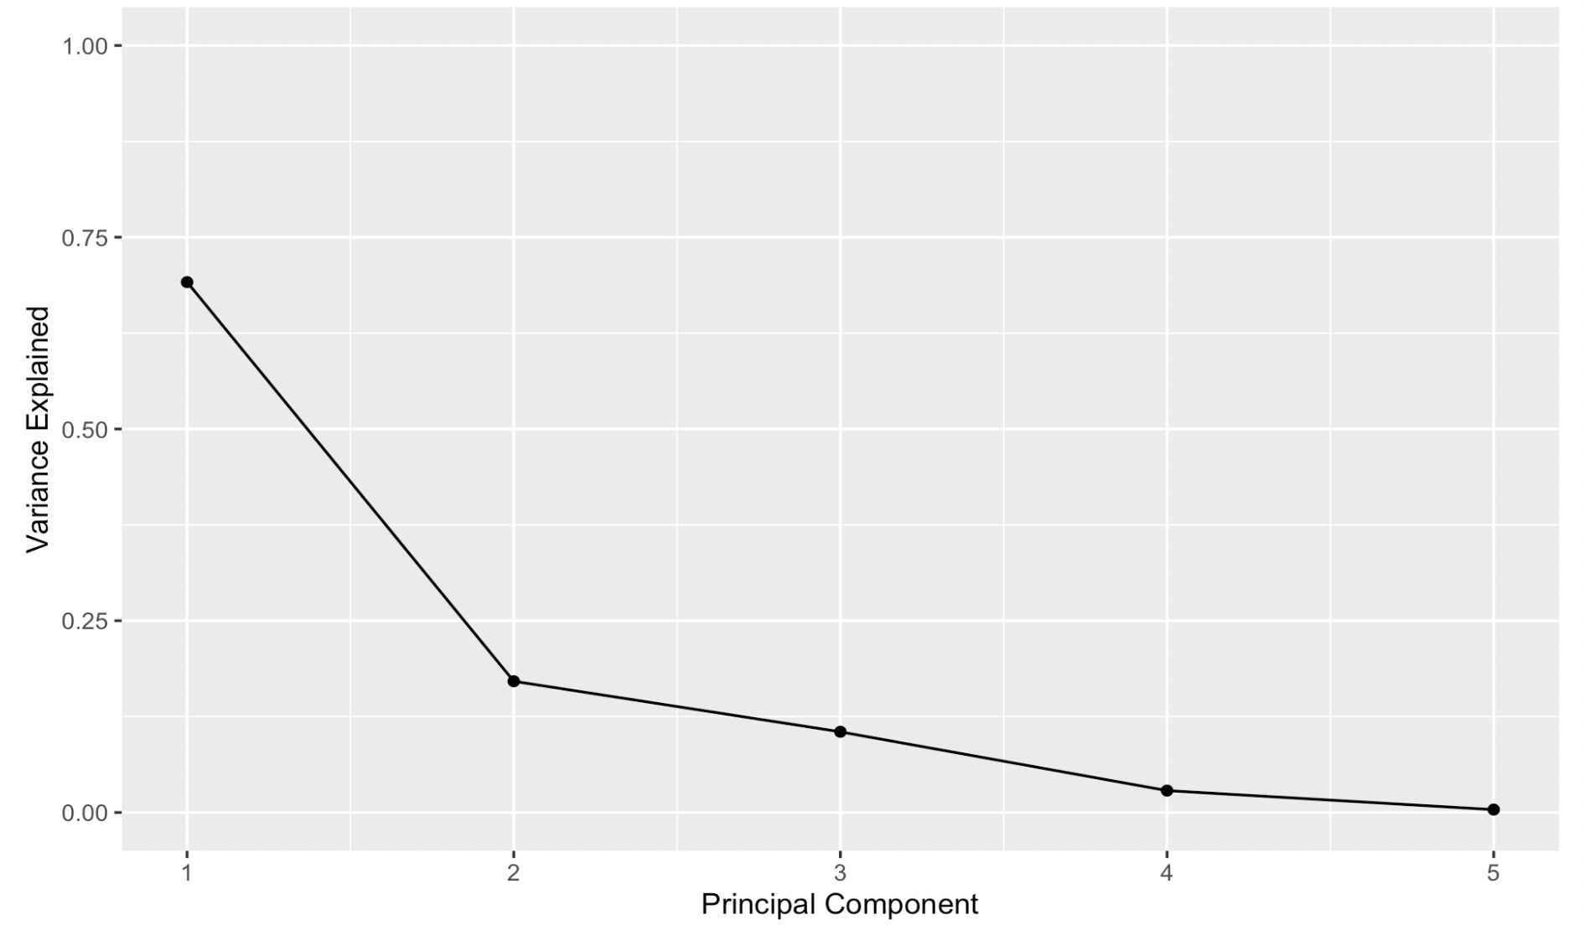
COMPONENTS TO KEEP
The First and Second Component have high correlation values
The Third Component explains 10% of variability but is almost exclusively Land Size
Best Bet: Including Three Components for modeling

Slide 22
USE CASE: DATA REDUCTION
Using top components to reduce data from 5 to 3 dimensions. Though this data set is small, it could be useful for an expanded version
USE CASE: INTERPRETABILITY
Population and Labor Force having the highest variability: points to circulation of opinion, mass dissatisfaction of government and time on hands
Land size having high influence in the third component- give room to civilians!
People, Economy, and Land can be major components combined to explain war

Slide 23
04
Factor Analysis
Investigating the components further

Slide 24
PCA METHOD: VARIMAX ROTATION LOADINGS
0.949
0.208
0.190
POPULATION
0.259
0.286
0.922
LAND SIZE
98% CUMULATIVE VARIANCE
EXPORTS
0.471
0.783
0.284
LABOR FORCE
0.929
0.272
0.228
MILITARY SPEND
0.153
0.944
0.203

Slide 25
FACTOR ANALYSIS OBJECTIVE
In general …
“Describe the relationships among many variables (covariance) in terms of a few underlying, but unobservable, random quantities called factors
“Model the interrelationships between items with the factors.”
In this case …
Understand the variables further
Re-establish the relationship mapped out from PCA
Uncover new interrelationships not foreseen prior

Slide 26
05
Further Discussion

Slide 27
KEY TAKEAWAYS
PRINCIPAL COMPONENT ANALYSIS
Was able to provide discernible information on the relationship between random variables that were mapped without cause.
FACTOR ANALYSIS
Mapped out the intuitive relationship of the coupled variables (Population & Labor, Exports & Military Spend, etc.) that could be difficult to detect in a bigger data set
CURRENT MODELING
War is not linear! Though a tested R-squared of 0.389 was accomplished it was after removing outliers, leading to bias. Non-parametric methods could lead to a better result.
FUTURE MODELING
Understanding war is doable with good techniques and data. But even with advanced machine learning models, predicting war is much harder.

Slide 28
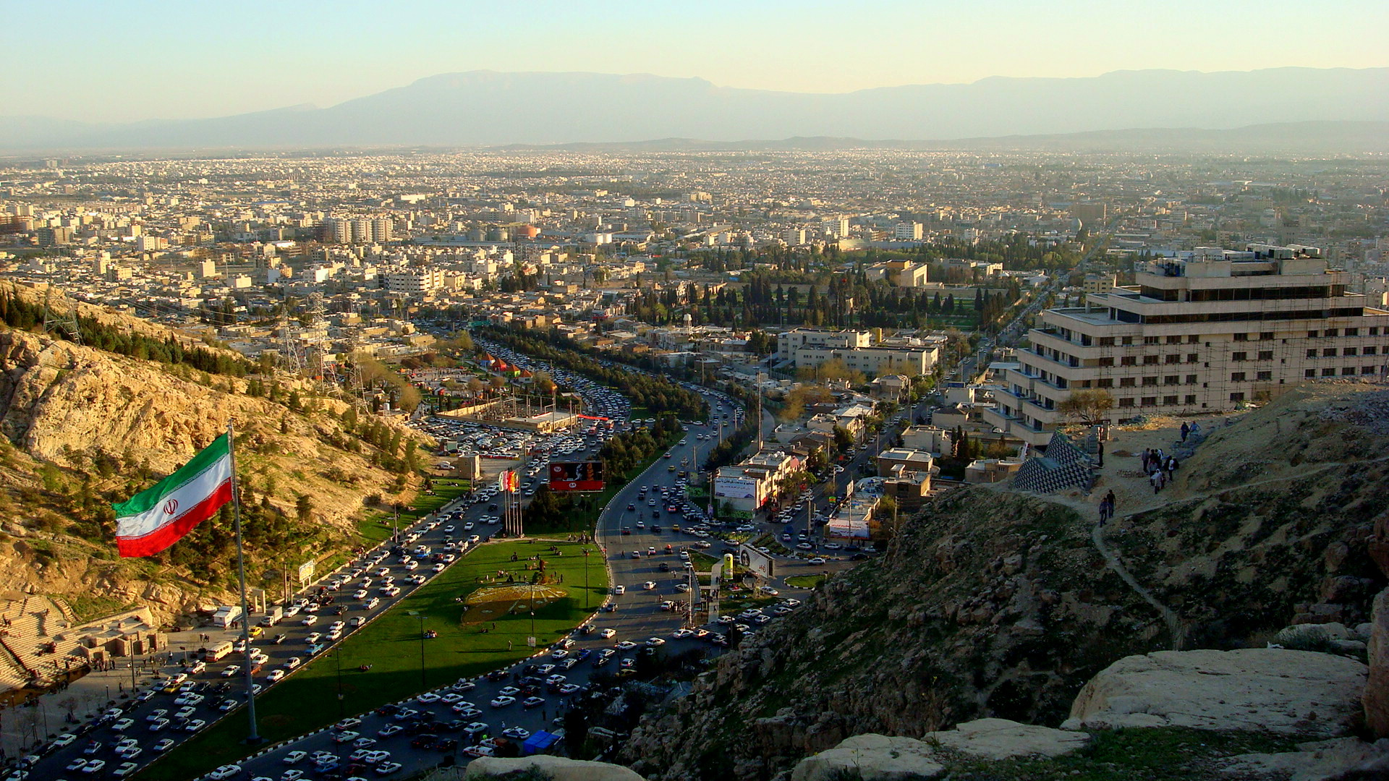
IRAN
51
100%
78%
2
INCIDENCES
INTRASTATE
KDPI & MEK
INTERNATIONAL
Iran was responsible for 1.7% of wars in the dataset.
Conflict where the government was on the offense and rebel groups were on the defense
KDPI - “Democratic Party of Iran and Kurdistan “ and MEK- ”People’s Mojahedin Organization of Iran” were in battle with the Iranian government for almost 60 years
Iran has had international involvement in territories not of its own in Iraq and Israel

Slide 29
IRAN
51
100%
78%
2
INCIDENCES
INTRASTATE
KDPI & MEK
INTERNATIONAL
Iran was responsible for 1.7% of wars in the dataset.
Conflict where the government was on the offense and rebel groups were on the defense
KDPI - “Democratic Party of Iran and Kurdistan “ and MEK- ”People’s Mojahedin Organization of Iran” were in battle with the Iranian government for almost 60 years
Iran has had international involvement in territories not of its own in Iraq and Israel

Slide 30
IRAN
51
100%
78%
2
INCIDENCES
INTRASTATE
KDPI & MEK
INTERNATIONAL
Iran was responsible for 1.7% of wars in the dataset.
Conflict where the government was on the offense and rebel groups were on the defense
KDPI - “Democratic Party of Iran and Kurdistan “ and MEK- ”People’s Mojahedin Organization of Iran” were in battle with the Iranian government for almost 60 years
Iran has had international involvement in territories not of its own in Iraq and Israel

Slide 31
IRAN
51
100%
78%
2
INCIDENCES
INTRASTATE
KDPI & MEK
INTERNATIONAL
Iran was responsible for 1.7% of wars in the dataset.
Conflict where the government was on the offense and rebel groups were on the defense
KDPI - “Democratic Party of Iran and Kurdistan “ and MEK- ”People’s Mojahedin Organization of Iran” were in battle with the Iranian government for almost 60 years
Iran has had international involvement in territories not of its own in Iraq and Israel

Slide 32

KOREA
9
100%
1
16
INCIDENCES
TERRITORY
OPPONENT
SUPPORTERS
Only 0.03% of the dataset involves South Korea.
All incidences involve one particular government (!) over territory
North Korea is the only major opponent on Side A (offensive) for all 9 incidences
16 governments listed in side_b_2nd, also known as allies in the conflict

Slide 33
KOREA
9
100%
1
16
INCIDENCES
TERRITORY
OPPONENT
SUPPORTERS
Only 0.03% of the dataset involves South Korea.
All incidences involve one particular government (!) over territory
North Korea is the only major opponent on Side A (offensive) for all 9 incidences
16 governments listed in side_b_2nd, also known as allies in the conflict

Slide 34
KOREA
9
100%
1
16
INCIDENCES
TERRITORY
OPPONENT
SUPPORTERS
Only 0.03% of the dataset involves South Korea.
All incidences involve one particular government (!) over territory
North Korea is the only major opponent on Side A (offensive) for all 9 incidences
16 governments listed in side_b_2nd, also known as allies in the conflict

Slide 35
KOREA
9
100%
1
16
INCIDENCES
TERRITORY
OPPONENT
SUPPORTERS
Only 0.03% of the dataset involves South Korea.
All incidences involve one particular government (!) over territory
North Korea is the only major opponent on Side A (offensive) for all 9 incidences
16 governments listed in side_b_2nd, also known as allies in the conflict

Slide 36
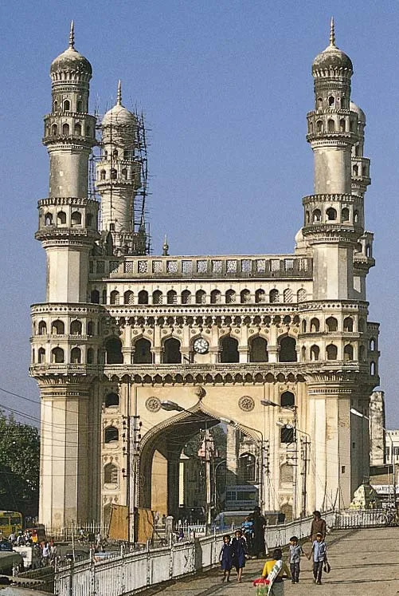
INDIA
216
71%
40
1
INCIDENCES
INTRASTATE
YEARS
NISH
Not only an outlier for every X variable, but also an outlier for Y- India has the 2nd highest number of wars in the data set after Myanmar
The majority of conflict in India (other than civilian conflict) is Intrastate, and the remainder is Interstate (Pakistan)
The most prevalent war over territory is the Kashmir war, which has been ongoing since 1984 on the eclipse of a 40 year war involving several parties
At least one Nishath is of Indian ethnicity (me)

Slide 37
INDIA
216
71%
40
1
INCIDENCES
INTRASTATE
YEARS
NISH
Not only an outlier for every X variable, but also an outlier for Y- India has the 2nd highest number of wars in the data set after Myanmar
The majority of conflict in India (other than civilian conflict) is Intrastate, and the remainder is Interstate (Pakistan)
The most prevalent war over territory is the Kashmir war, which has been ongoing since 1984 on the eclipse of a 40 year war involving several parties
At least one Nishath is of Indian ethnicity (me)

Slide 38
INDIA
216
71%
40
1
INCIDENCES
INTRASTATE
YEARS
NISH
Not only an outlier for every X variable, but also an outlier for Y- India has the 2nd highest number of wars in the data set after Myanmar
The majority of conflict in India (other than civilian conflict) is Intrastate, and the remainder is Interstate (Pakistan)
The most prevalent war over territory is the Kashmir war, which has been ongoing since 1984 on the eclipse of a 40 year war involving several parties
At least one Nishath is of Indian ethnicity (me)

Slide 39
INDIA
216
71%
40
1
INCIDENCES
INTRASTATE
YEARS
NISH
Not only an outlier for every X variable, but also an outlier for Y- India has the 2nd highest number of wars in the data set after Myanmar
The majority of conflict in India (other than civilian conflict) is Intrastate, and the remainder is Interstate (Pakistan)
The most prevalent war over territory is the Kashmir war, which has been ongoing since 1984 on the eclipse of a 40 year war involving several parties
At least one Nishath is of Indian ethnicity (me)

Slide 40
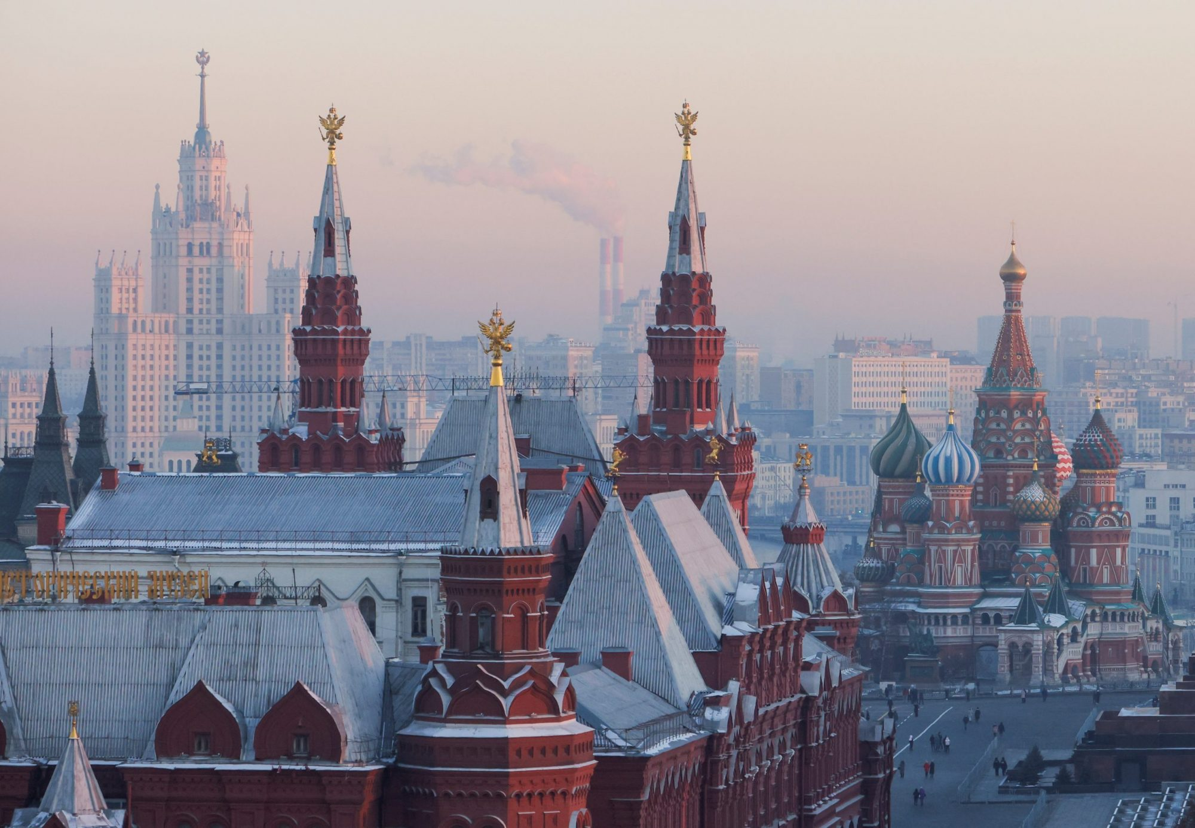
RUSSIA
58
35%
100%
4
INCIDENCES
INTENSITY
INCOMPATIBILITY
TERRITORIES
Though this count must have risen after 2021, the dataset features 58 wars on Russian territory
35% of the incidences were unfortunately at an intensity level of 2, meaning over 1,000 deaths per incident
All involved parties and conflict was regarding dissatisfaction over government or an issue revolving the government.
Major regions involved in conflict with Russia: Caucus Emirate(group), Ukraine, Chechnya, Novorossiya

Slide 41
RUSSIA
58
35%
100%
4
INCIDENCES
INTENSITY
INCOMPATIBILITY
TERRITORIES
Though this count must have risen after 2021, the dataset features 58 wars on Russian territory
35% of the incidences were unfortunately at an intensity level of 2, meaning over 1,000 deaths per incident
All involved parties and conflict was regarding dissatisfaction over government or an issue revolving the government.
Major regions involved in conflict with Russia: Caucus Emirate(group), Ukraine, Chechnya, Novorossiya

Slide 42
RUSSIA
58
35%
100%
4
INCIDENCES
INTENSITY
INCOMPATIBILITY
TERRITORIES
Though this count must have risen after 2021, the dataset features 58 wars on Russian territory
35% of the incidences were unfortunately at an intensity level of 2, meaning over 1,000 deaths per incident
All involved parties and conflict was regarding dissatisfaction over government or an issue revolving the government.
Major regions involved in conflict with Russia: Caucus Emirate(group), Ukraine, Chechnya, Novorossiya

Slide 43
RUSSIA
58
35%
100%
4
INCIDENCES
INTENSITY
INCOMPATIBILITY
TERRITORIES
Though this count must have risen after 2021, the dataset features 58 wars on Russian territory
35% of the incidences were unfortunately at an intensity level of 2, meaning over 1,000 deaths per incident
All involved parties and conflict was regarding dissatisfaction over government or an issue revolving the government.
Major regions involved in conflict with Russia: Caucus Emirate(group), Ukraine, Chechnya, Novorossiya

